Slide 1


Company Plan
We R One
Dec 31, 2000

Slide 2
Group Members
Amwaj Alshamrani
Hussain Alibrahim
Khulud Alawaji
Latifah Alhwiseen
Mariam Alhawiti
Dec 31, 2000

Slide 3




Presentation Agenda
Gender Equality
COVID-19 Impact
Bonus Distribution
Q & A

Slide 4

01
Gender Equality
Equal

Slide 5
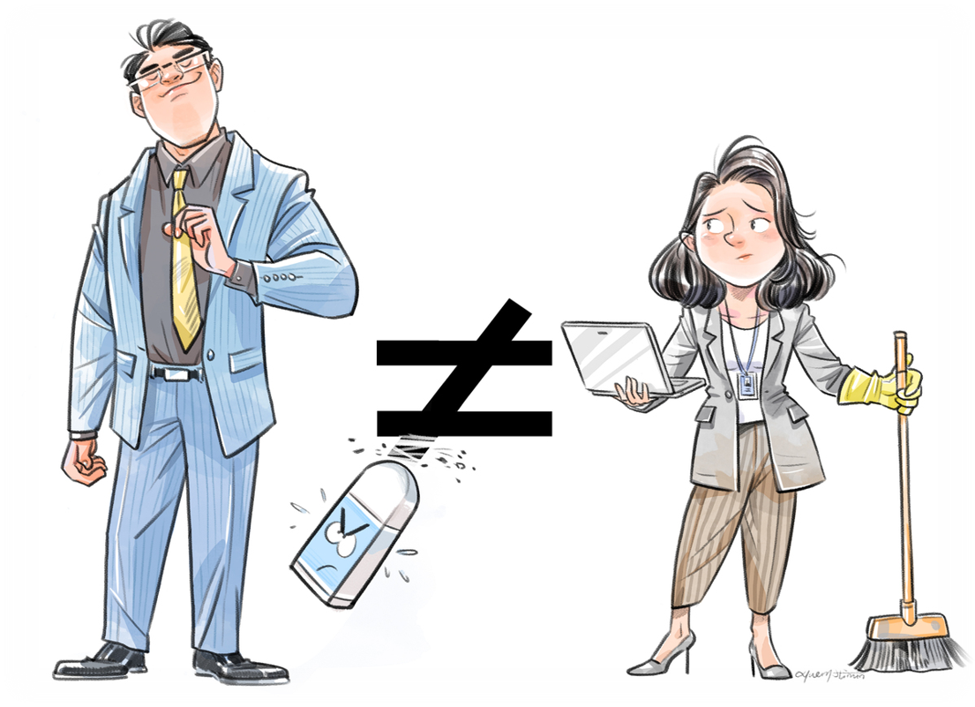
Company Values
We R believing in equal gender rights in the workplace.

Slide 6
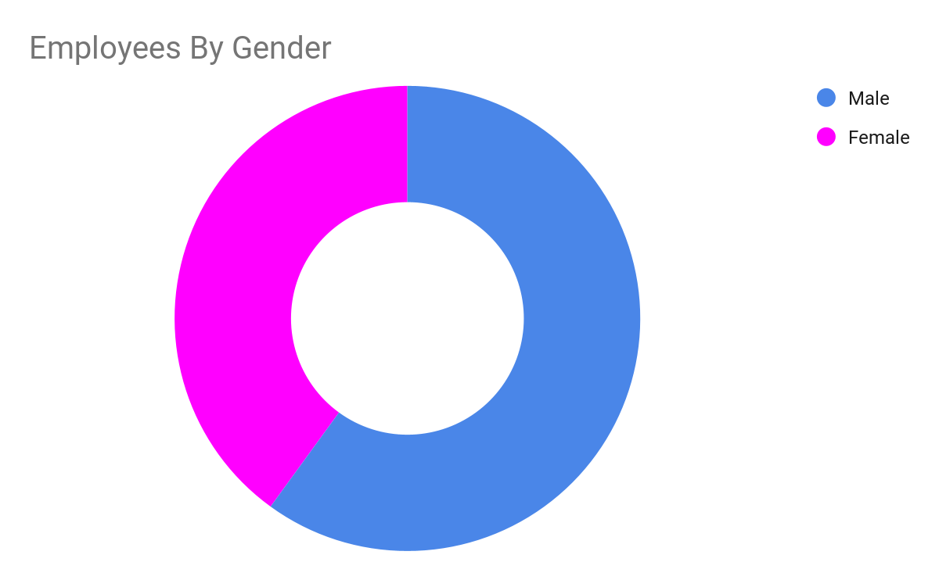


Employee Ratio By Gender
01
Gender Equality
40%
60%
of the hired employees are females
of the hired employees are males

Slide 7
Overall Female to Male Ratio
01
Gender Equality
1985-1990
1995-2000
1:1.49
1:1.52
Gender Equality achieved by 2005
1990-1995
2000 Onwards
1:1.5
1:1
Our plan to achieve 1:1 female to male ratio

Slide 8
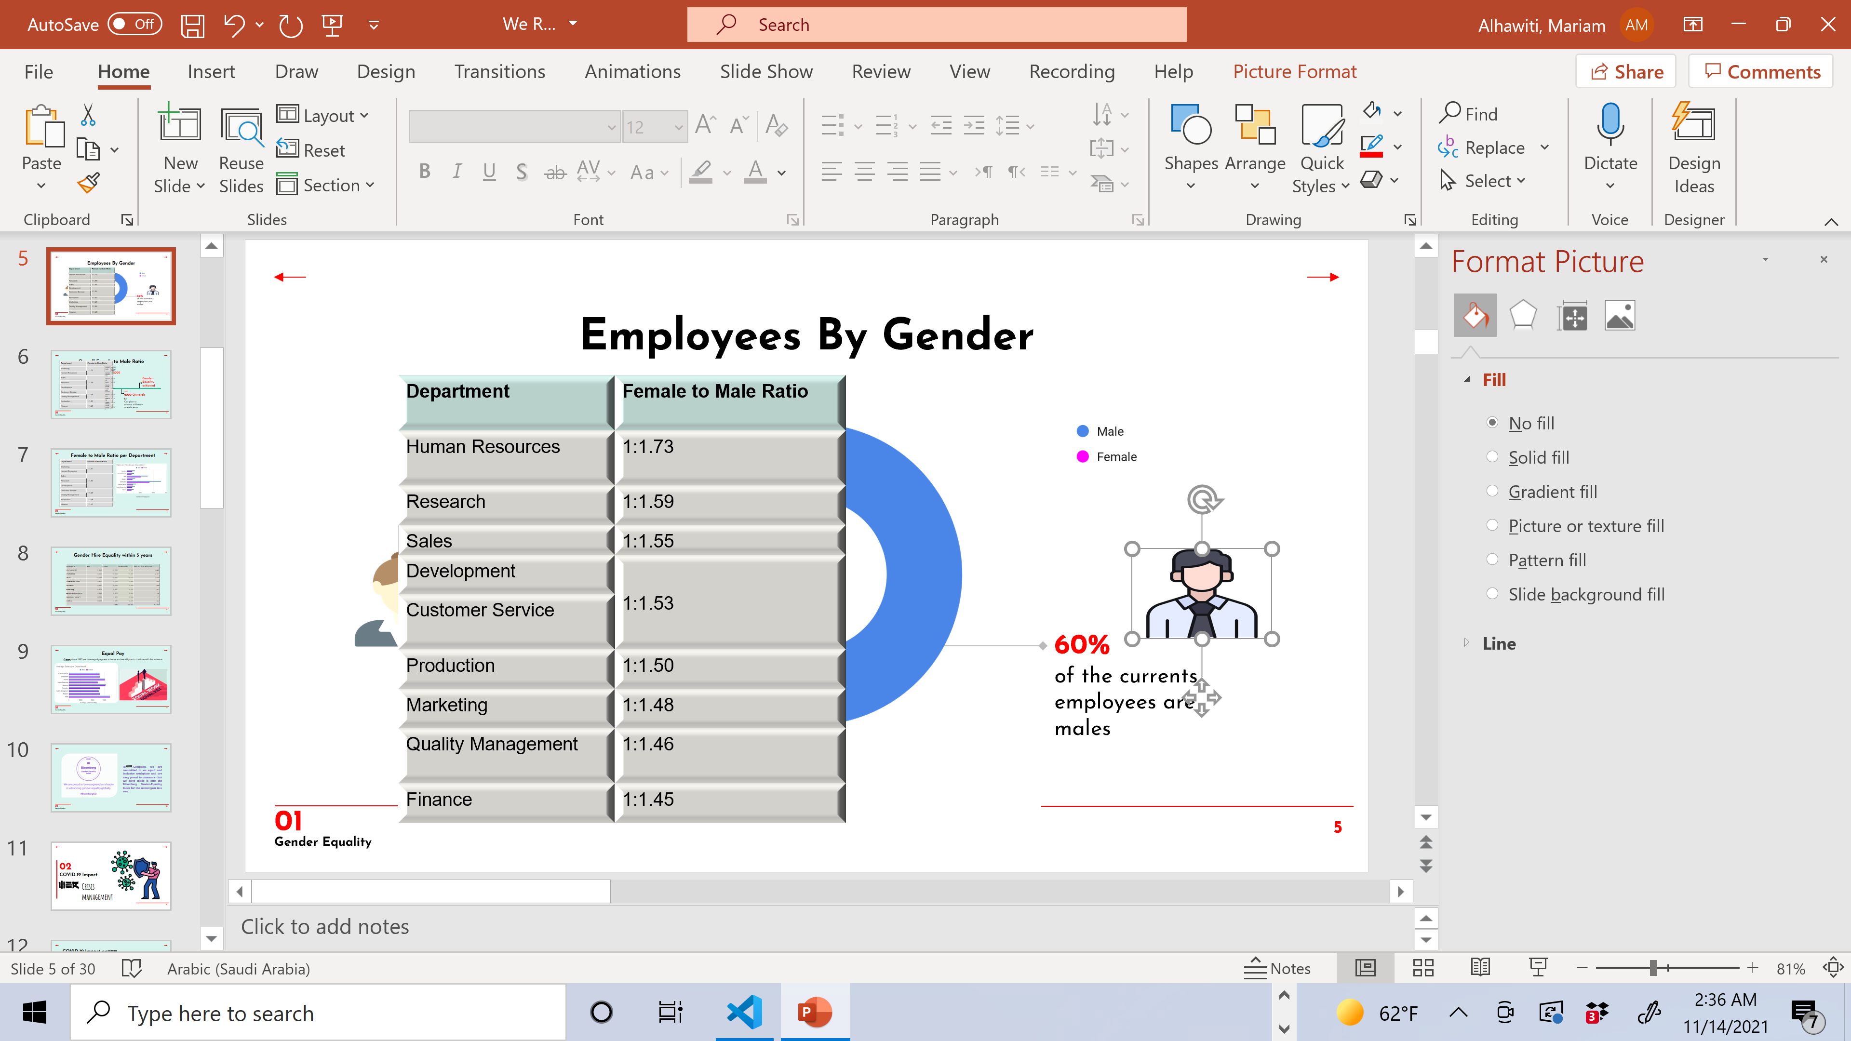
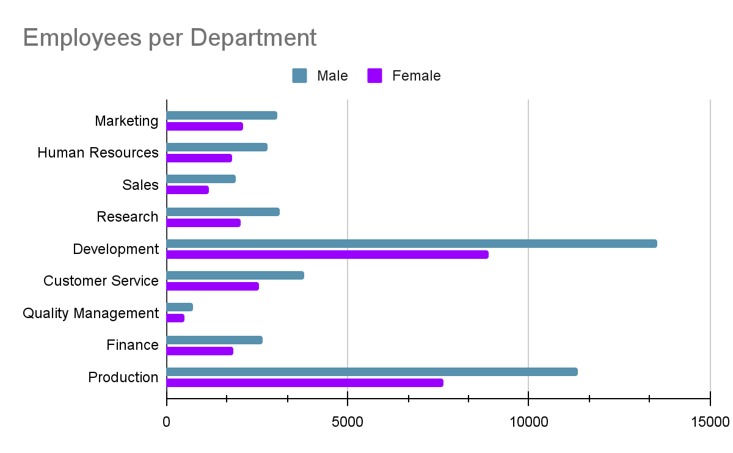
Female to Male Hire Ratio for the past 5 years
01
Gender Equality
Department | Female to Male Ratio
Human Resources | 1:1.73
Research | 1:1.59
Sales | 1:1.55
Development | 1:1.53
Customer Service
Production | 1:1.50
Marketing | 1:1.48
Quality Management | 1:1.46
Finance | 1:1.45
Department
Number of Employees

Slide 9
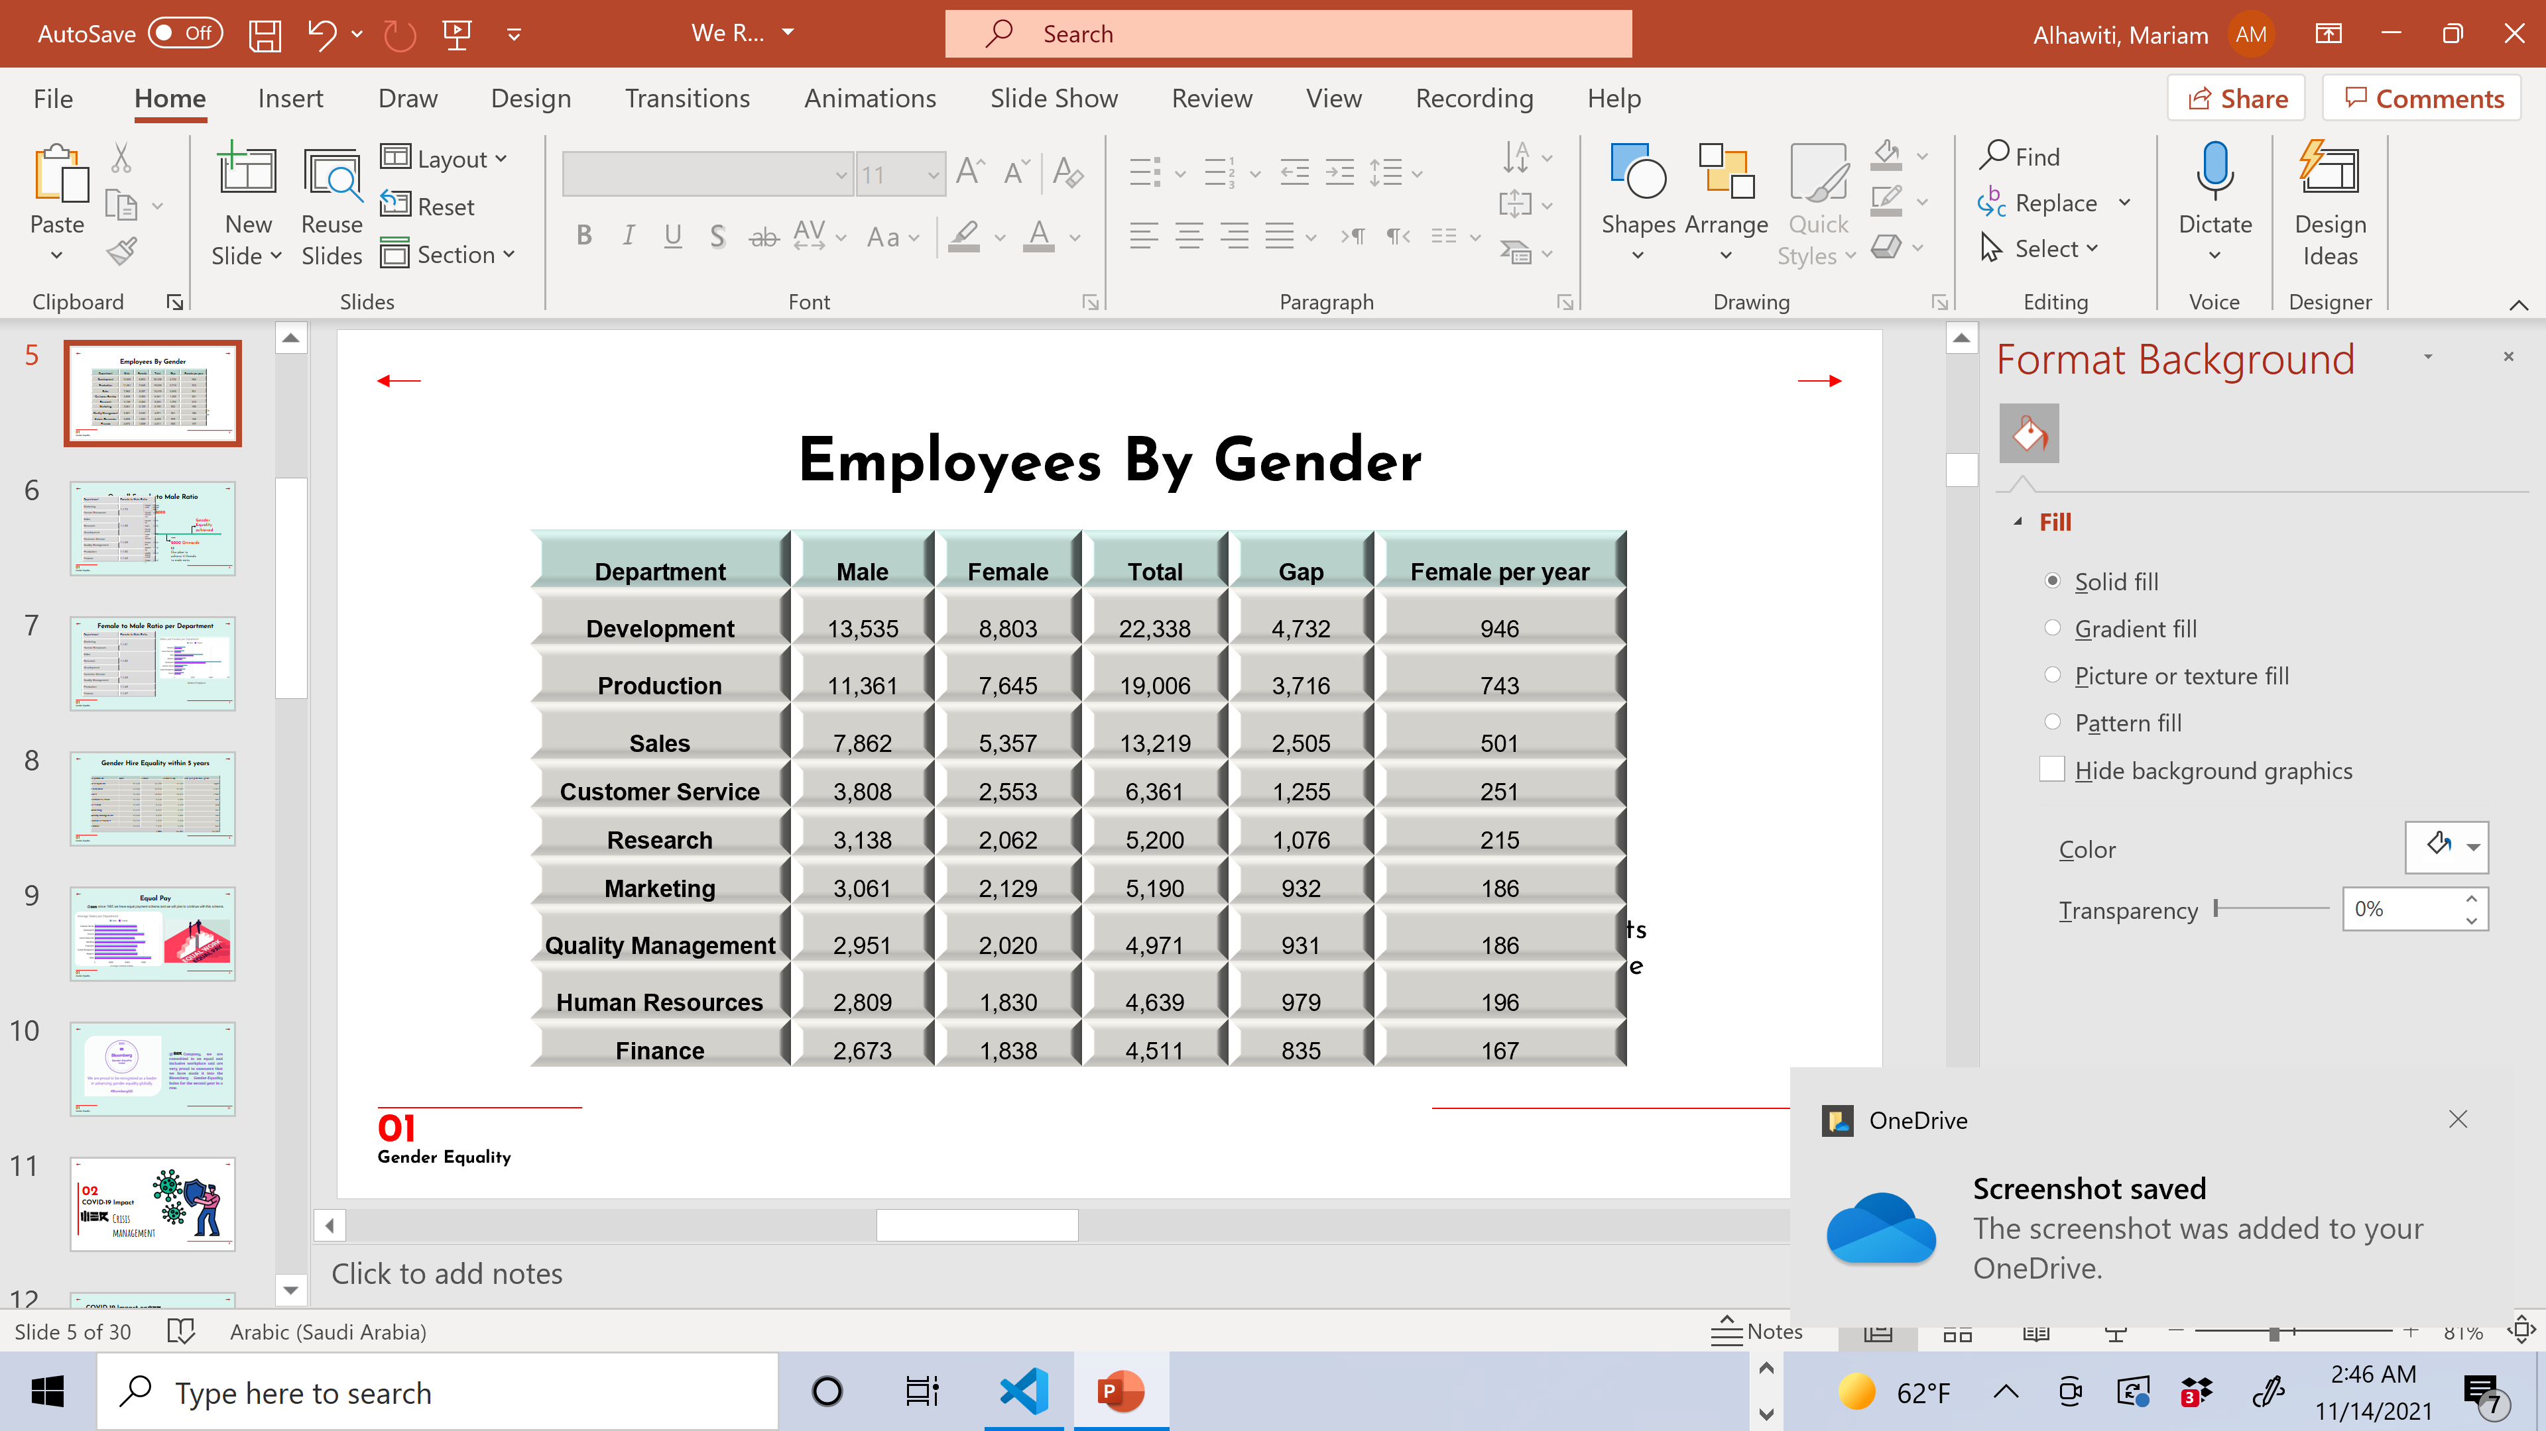
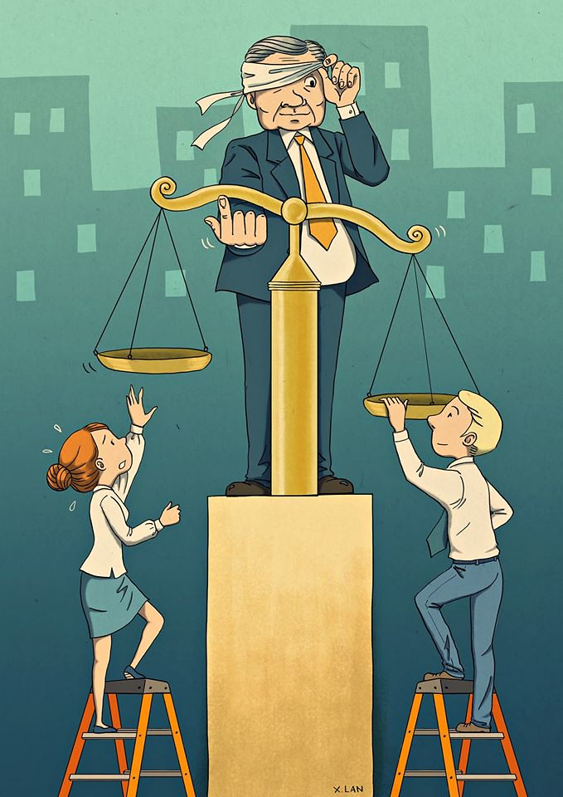
Employees Gender Equality
01
Gender Equality
Our target: reach 1:1 ratio in all departments by 2005.

Slide 10


Employees Gender Equality
01
Gender Equality
Based on data analysis, the annual average hire rate is 6% of the total number of employees.
To achieve gender equality, the identified gender gap should be considered upon hiring new staff.

Slide 11








Employees Gender Equality
01
Gender Equality
Development Department
6% --> 1,340
Year | Male | Female | Total Male | Total Female
1 | 197 | 197+946 | 13,732 | 9,946
2 | 197 | 1,143 | 13,929 | 11,089
3 | 197 | 1,143 | 14,126 | 12,232
4 | 197 | 1,143 | 14,323 | 13,375
5 | 197 | 1,143 | 14,520 | 14,518
22,338​
13,535
8,803
4,732 - 946 per year

Slide 12
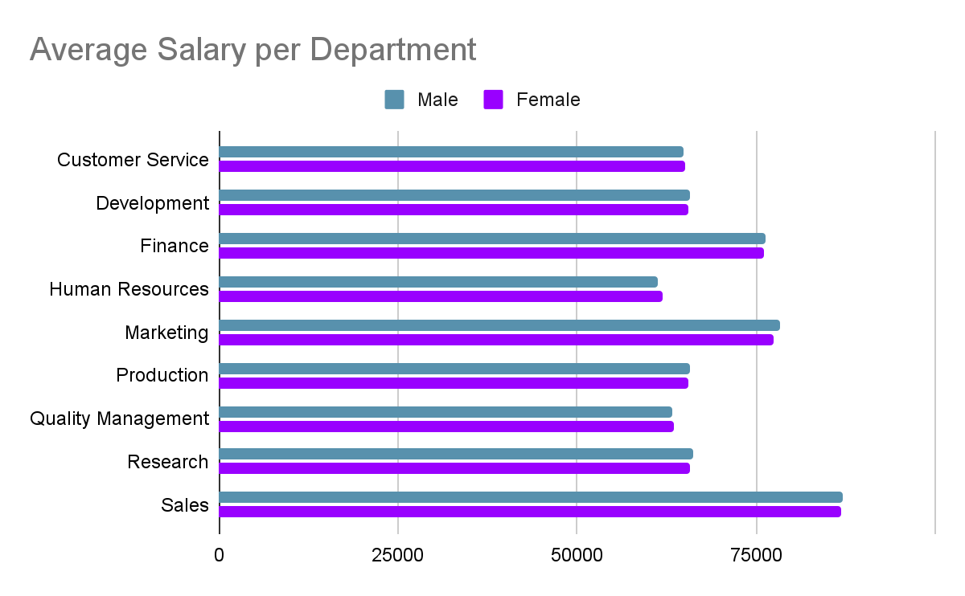

Equal Pay
01
Gender Equality
@ since 1985 we have equal payment schema and we will plan to continue with this schema.
Average Annual Salary

Slide 13

02
COVID-19 Impact
Crisis
management

Slide 14

COVID-19 Impact on
02
COVID-19 Impact
The Coronavirus pandemic affected all businesses negatively. The level of unemployment increased and many organizations declared bankruptcy. However, @ the management decided to keep all the staff with salary reduction schema to save about 20% its cost.

Slide 15

COVID-19 Salary Reduction
02
COVID-19 Impact
Our aim is to save 20% of the total salaries cost without terminating anyone of our precious employees.

Slide 16


Reduction Plan
02
COVID-19 Impact
=> 100k
32%
100 < => 90
30%
EMPLOYESS
90< => 80
29%
80< => 70
28%
70< => 60
24%
=< 60k
16%

Slide 17
Salaries Reduction Schema
Total Salaries
20%
$ 4,521,126,180
$ 904,238,635
02
COVID-19 Impact
Salary Range | Total Salaries | Reduction % | Reduction Amount
S => 100k | 41,931,993 | 32% | 13,418,238
100 < S => 90k | 112,865,481 | 30% | 33,859,644
90k < S => 80k | 282,029,324 | 29% | 81,788,503
80k < S => 70k | 524,588,765 | 28% | 146,884,854
70k < S => 60k | 760,238,968 | 24% | 182,457,352
S < 60k | 2,799,771,649 | 16% | 447,963,464
Total Reduction |  |  | 906,372,056

Slide 18
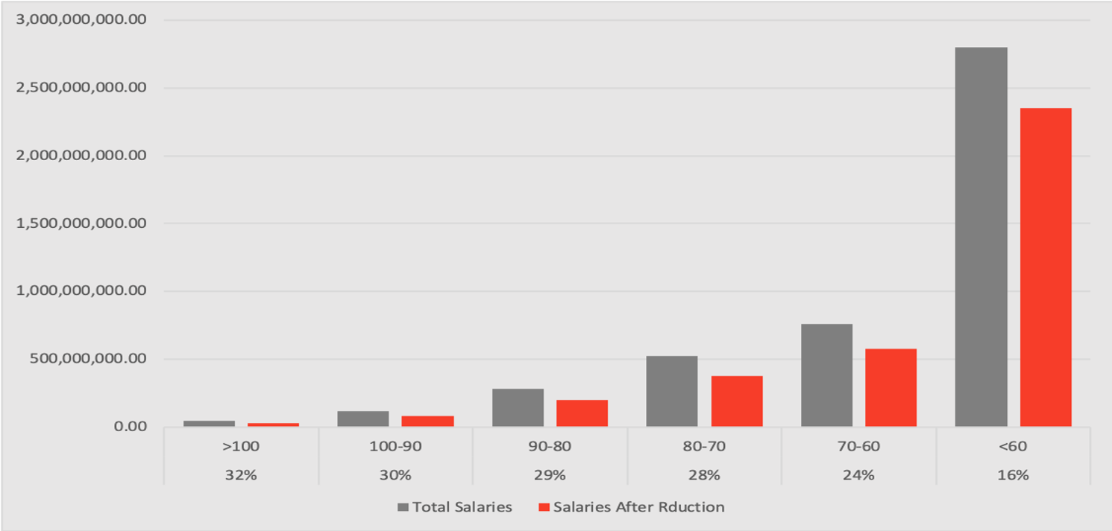
Salaries Reduction
02
COVID-19 Impact
Total Salaries
Salary Group and Reduction Percentage

Slide 19

COVID-19 Employees Survey
02
COVID-19 Impact
We have conducted a survey to engage our employees and record their responses to our COVID-19 reduction policy.

Slide 20

03
Bonuses Distribution

Slide 21

$50,000,000.00
03
Bonuses Distribution
The total amount of bonus!

Slide 22

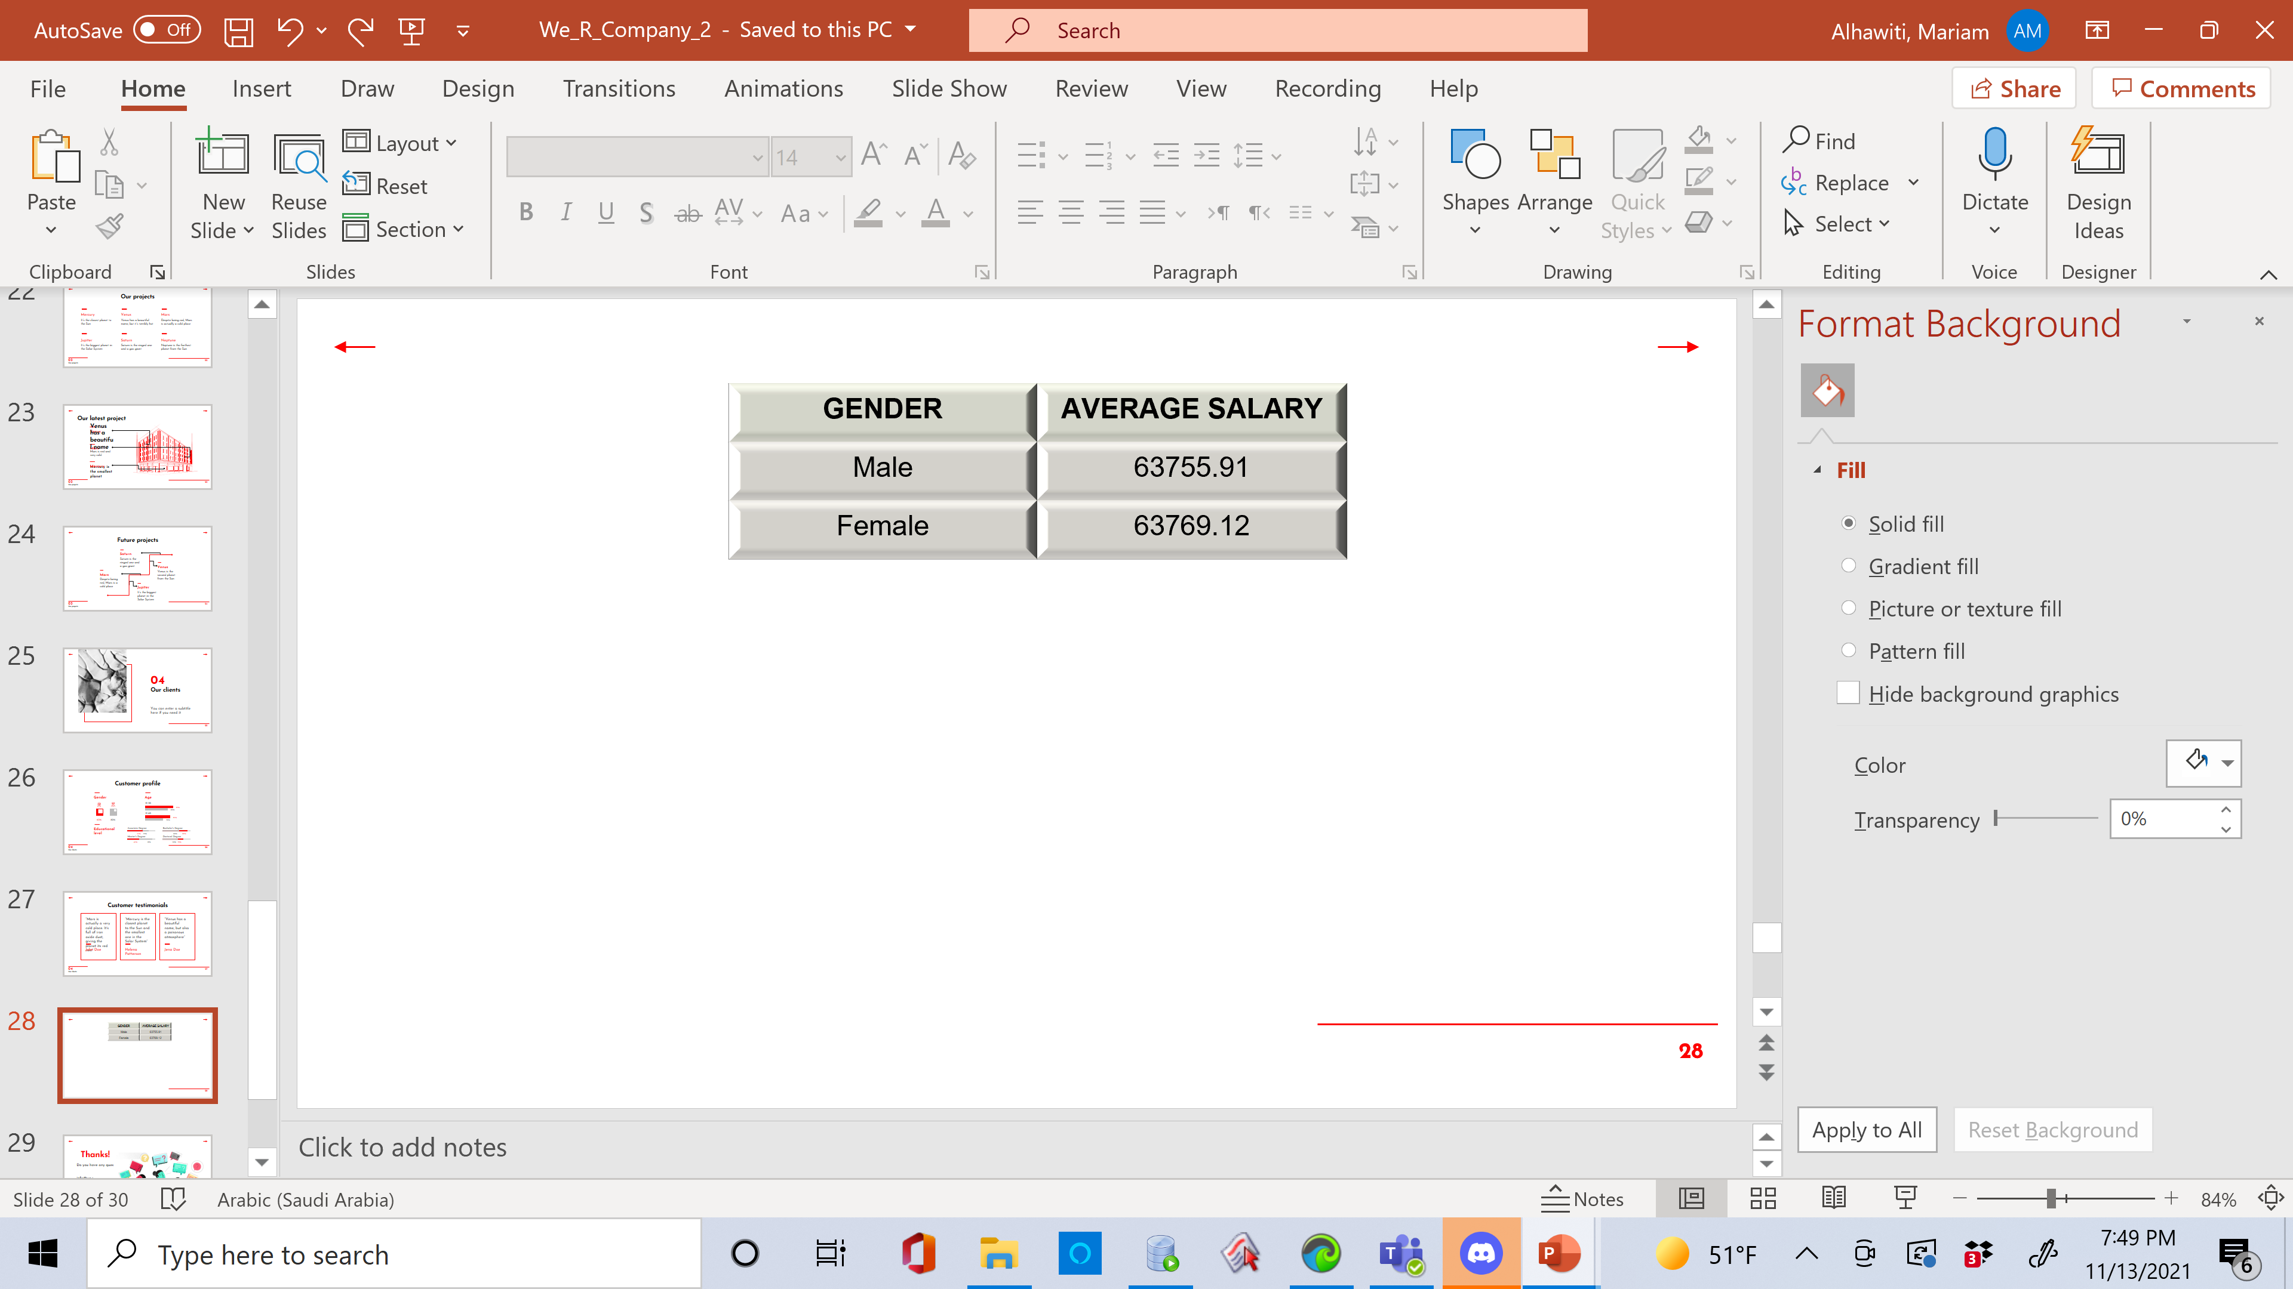
03
Bonuses Distribution
Average salary
This is the average salary for males and females in the company.

Slide 23

03
Our projects
Other factors
Years of service
Contracts that are ending soon

Slide 24


1-YEARS OF SERVICE
03
Bonuses Distribution
 | 11-15 | 6-10 | 0-5
2%
1.5%
1%

Slide 25
for contracts ending before 01-feb-2001
+0.7%

Slide 26
$49,752,461.67
03
Bonuses Distribution
Total amount of bonus!

Slide 27

Thanks!
Do you have any questions?
info@we.r
Fax: +966 313 3444
we.r

